Slide 1
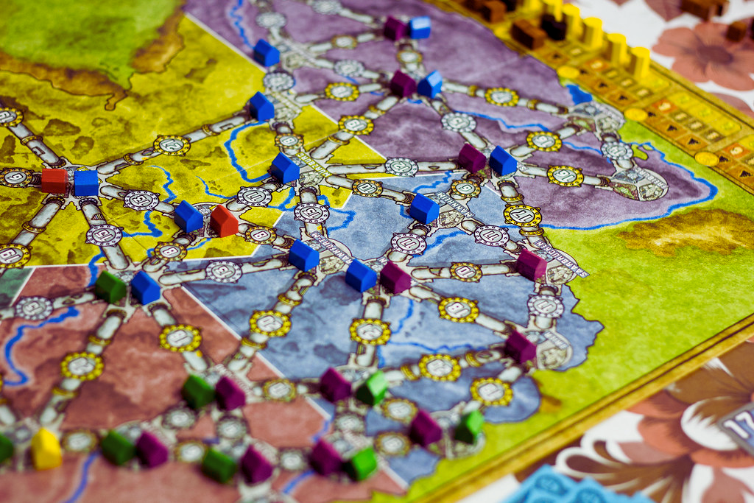
Multi-Agent Systems
POWER-GRID GAME
WORK BY: EDUARDO PASSOS, PEDRO FERNANDES AND RAFAEL PACHECO

Slide 2
THE GAME TO DEVELOP
Transforming a Board Game into a MAS
In Power Grid, players compete to build up electrical networks from scratch and be the player to power the most cities at the end of the game.
Each player represents a company which owns power plants and tries to supply electricity to cities.
The objective of Power Grid is to supply the most cities with power when someone's network gains a predetermined size.
In this project we planned and created the interactions between the board, and the players, in the different phases of the game.
Some rules were simplified, due to the non-impact they would have on the interactions among agents, and the difficulty of programming them efficiently.

Slide 3
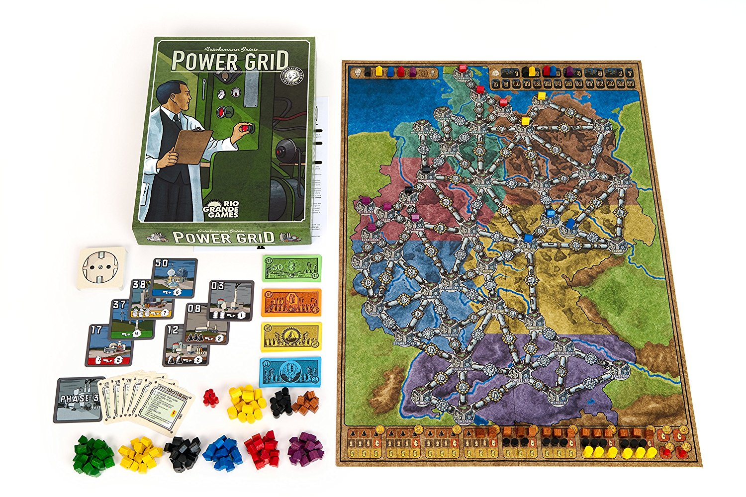
AGENTS AND OBJECTS
Summary of the elements of the project
Game Manager
This agent sends messages to all players, informing the game phase, and what actions to make.
Player Agents
They act and make decisions given the messages by the manager and the other player agents.
Environment
Holds all the information of the board, including the player inventories, power plant market, and resources available.

Slide 4
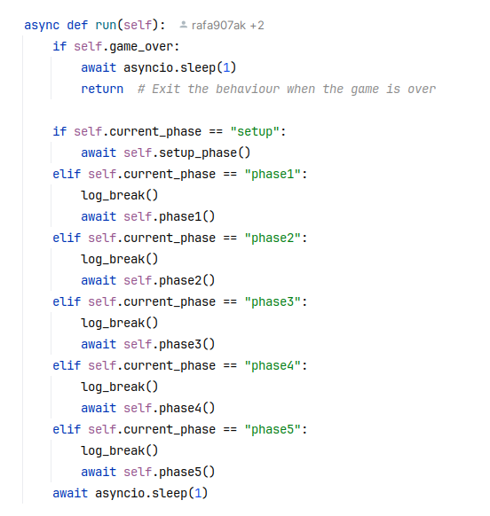
GAME MANAGER
The Game Manager Agent, is essential to conduct the game flow and ensure that the player’s actions take time in their respective moment.
This is a Simple Reflex Agent, meaning it does not exhibit intelligence or complex decision-making.
Its actions are purely reactive and dictated by the current game phase and sub-phase, which is based on a fixed sequence. It does not adapt its behavior or decisions based on external factors.
It is responsible for the following:
Manage the game flow,
Conduct the auction on phase II,
Manages the environment maintenance along the way, at the end of phase V.

Slide 5
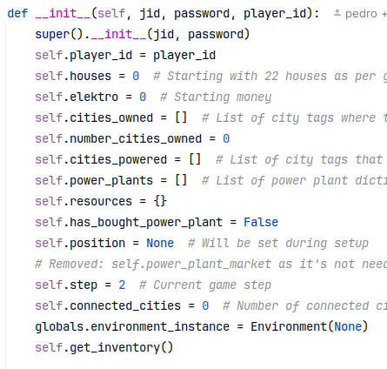
PLAYER AGENT
Each Player Agent simulates the normal behavior of a person who’s playing the game. Given the order established by the manager, it makes decisions taking in consideration the current board state.
This is a Model-based Reflex Agent, meaning it is still rigid as their decisions are encoded into rules. However, the decisions vary considering the state of the environment and the phase of the game, as well as its own inventory.
It is responsible for the following:
Make decisions to the play-making,
Retrieve the state and change the environment, by buying cities and power plants, and also manage resources.
Each agent has access to the environment and their inventory, as seen in the right.

Slide 6
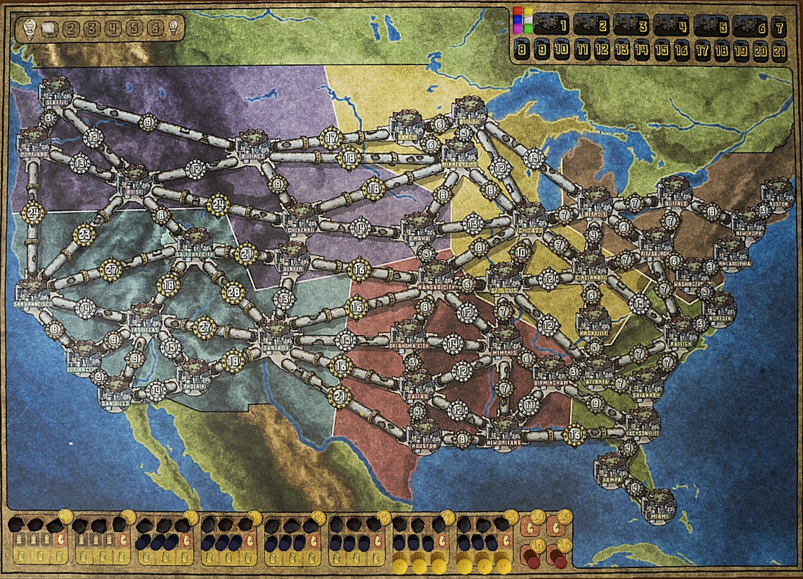
ENVIRONMENT
The environment contains a representation of all the information visible on the board.
It is not an agent, since it only holds different objects of the board. Just like in real life, a board doesn’t talk.
The environment contains different objects:
I) Map Graph of the US version of the map, with all the edges and vertices of the original map
II) The inventory of all players, since it is public and a part of the board*
III) The current and future Power Plant Market, which is an object by itself.
IV) Houses, Elektro (Game Currency), Pieces and Power Plant Cards
* Each player can modify their own inventory but is limited to viewing the inventories of other players

Slide 7
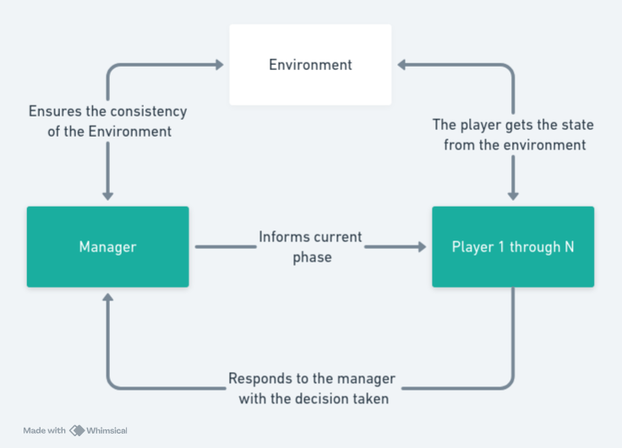
EXPERIMENTATION - ROBUSTNESS
This project, which follows the flow outlined on the left, allowed for the evaluation of:
The strategic effectiveness of player agents, which was adapted throughout the development,
The efficiency of the game management, centralized on the ‘Manager’ agent,
The system’s ability to deal with a multitude of conditions and special cases.
The latter is arguably the most important part, which is to guarantee that the dynamic interaction of the three elements does not break any of the rules throughout the game experience.

Slide 8
EXPERIMENTATION - CONFIGURATION
We designed our MAS with the goal of making its components easily configurable and customizable:
The whole project was taken in consideration that any given number from 2 to 6 players is possible and can be changed on ‘main.py’,
The agent capabilities regarding the decisions taken in each phase are easily accessible and can be changed.
The initial setup of the game follows the “Recharged-Version’ rules, and all the dictionaries are defined accordingly. However, this initial setup can be changed to evaluate the behavior of the agents.
The Power Plant deck and Resources can be easily accessed and changed. For example, available resources, powerplants, and their respective prices are all modifiable.
The game-flow will still be functional, as long as these changes don’t violate any of the game’s core principles.

Slide 9
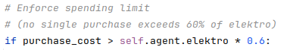
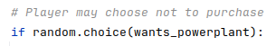
EXPERIMENTATION – NON-LINEAR BEHAVIOR
Prior to understanding how challenging this idea would be, our aim was to produce a project where the player agents would learn the best strategies to act upon, and ultimately, improve their decision making.
Despite the overwhelming rule complexity enforced by Power Grid, we still decided to implement some non-linear factors in our agents’ decision functions, such as:
Players will never spend all of their funds on Resources or Power Plants, encouraging them to purchase more cities, potentially accelerating the game-ending triggers
Randomness in Power Plant purchase decision, where a player will sometimes choose not to purchase a Power Plant even though they have the funds to do so

Slide 10



MEET THE POWER-GRID TEAM
Pedro Fernandes
Environment and Presentation Engineer
Thank you for your attention!
Eduardo Passos
Communication and Logic Developer
Rafael Pacheco
Object Design and Full Stack Debugger

